Slide 1
Pine Loch Sun Beach Club
Annual Membership Meeting
September 17, 2016

Slide 2
Meeting Agenda
Board Introduction & Guiding Principles
Committee Reports
Maintenance, Roads – Randy
Water - Mark
Treasury – Mark for Bonnie
Architecture - Bob
Fire Wise – Linda Orndorff
Technology – Mark (for Dave)
Priorities overview
2016 / 2017 Operating budget - discussion and vote
Open board position solicitation & vote
Conclusion

Slide 3
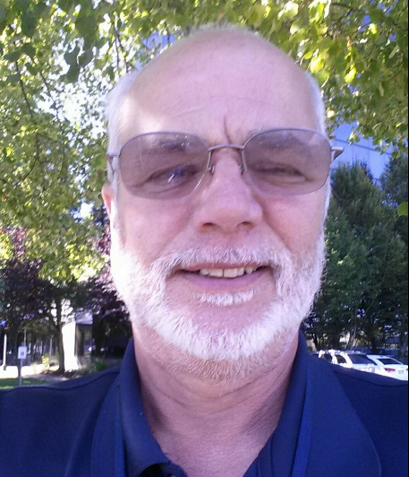
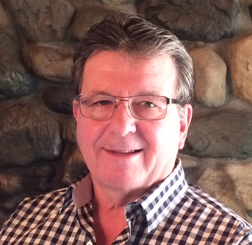
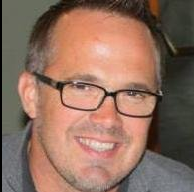
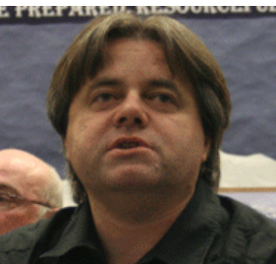
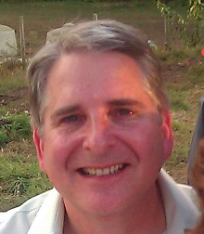
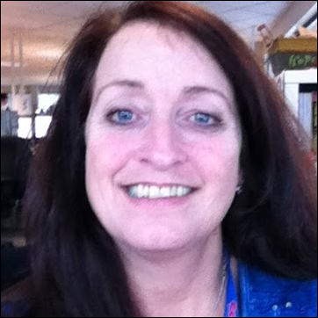
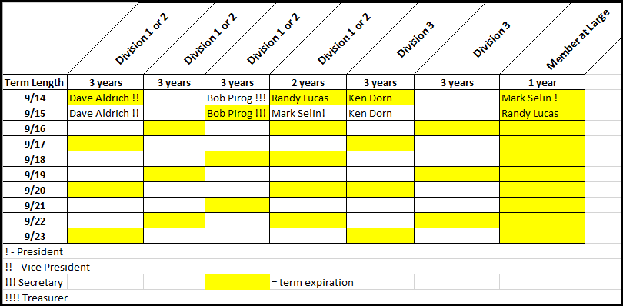
Your Current Board
Bob Pirog
Secretary
Randy Lucas
Roads & Maintenance
Ken Dorn
Dave Aldrich
Vice-President
Mark Selin
President
Bonnie Steinlein
Treasurer
Open #1
Our guiding principles:
Transparency of progress regarding agreed membership priorities (Water, Roads, & Maintenance)
Consistency of communication via multiple methods (website, email, postal mail, etc.)
Continuous improvement in how PLS is managed – for the good of our membership community

Slide 4
Committee Updates
ROADS
Acquired 1000 tons of recycled asphalt & applied to Upper PLS Drive, W Lakedale, Lakeview drive and Tom Write Road Between Parking lot and gate.
Applied lignin to roads for dust abatement
Graded and rolled all roads
Culvert upgrade in PLS 1&2
100 tons of reclaimed purchased and used for road repair in Div 3
Plan to complete road system with reclaimed asphalt next year
Ditch improvement in Div3 Before snow
Ditch improvement PLS Drive and Bonnie View before snow

Slide 5
Committee Updates
MAINTENANCE
Wooden signs refurbished
Replaced flag pole
Re-Plumbed pool Mechanical room.
Replaced sand in sand filter
Installed a flow meter
Installed pool heater in spring (purchased last fiscal year)
Repaired pool fence crushed by falling tree
Purchased and installed incremental lighting and replaced fan in Lodge
Acquired a road sander for winter ice.
Replaced porch lakeside on rental house
Acquired a new to use welder.
Acquired and installed new shades and valances for lodge

Slide 6
Committee Updates
Water
Secured sanitary containment area around wellhead (including filing of restrictive covenants for land title)
Completed water meter installations on 3 remaining lots (we have 8 remaining of 11) & repaired settling
Insulated and re-plumbed chlorination station
Prepared station 2 (Div 3) for emergency power (to be complete in next 2 months)
Refined maintenance schedule for pumps and spares (including rebuild)
Re insulate and finish inside of sta 1
Rebuilt station 2 pump Div 3
Facilitated the completion of the Fiber Optic Installation project

Slide 7
Treasury Summary
What’s new:
Transitioned to full service accounting firm
Simplified chart of accounts
Updated reserve study serving as basis for yearly budget
What’s working well:
Simplified treasury reporting
Low accounts receivable
Responsible fiscal management (shopping bids, advanced planning, etc)
Establishing periodic maintenance schedules to improve budget planning
Strong balance sheet – including funding for reserves
Where we need to focus:
Working with Ideal to simplify membership reporting
Continue ‘Small Water system Plan’ incorporation as a key input to the reserve study
Enable members to pay dues electronically

Slide 8
Architecture and Fire Wise
Architecture
Processed 12 member requests for tree removal, 5 building requests
Fire Wise
Roving chipper deployed for third year
Revalidating pledged funding
Approved tree removal & other lot work to be scheduled following burn ban lift

Slide 9
Technology
Office and guest computers
Rebuild of office and guest computer following malicious virus
Simplified guest computer following vandalism (browser only)
Updated to current technology including safety controls to minimize risk of access to inappropriate websites

Slide 10
2016 / 2017 Budget
Provides for annual operations, planned projects (per reserve study and water plan) and accumulates reserves for longer term capital projects per reserve study.
Total 2015 / 2016 Budget: $516,672.00
Membership Dues
Developed lot: $1180.00
Undeveloped lot: $1060.00
Wildwood lot: $590.00

Slide 11
Thank you Randy!!

Slide 12
Board nominations
Bob Pirog
Secretary
Open #1
Ken Dorn
Roads & Maintenance
Dave Aldrich
Vice-President
Mark Selin
President
Bonnie Steinlein
Treasurer
Open #2
Our guiding principles:
Transparency of progress regarding agreed membership priorities (Water, Roads, & Maintenance)
Consistency of communication via multiple methods (website, email, postal mail, etc.)
Continuous improvement in how PLS is managed – for the good of our membership community

Slide 13
Any other business?

Slide 14
Thank You!!!
Danke
Grazie
धन्यवाद
Gracias
ありがとう
Спасибо
مرسي
Dzięki
مہربانی
Takk
Kiitos
شكر
Obrigado
唔該
감사합니다
Merci
感謝你
Teşekkürler

