Slide 1
PINELOCH SUN BEACH CLUB Quarterly HOA Meeting
January 23, 2021

Slide 2
ZOOM MEETING TIPS
Welcome - we’re so glad you’re here.
Meeting will be recorded and used for meeting minutes.
Presenter will mute microphones during the presentation to help with background noise.
We’ll unmute and pause after each section for questions.
You are also welcome to put a question/comment in the chat and the moderator will ask the question for you.
Member engagement is welcome and encouraged.

Slide 3
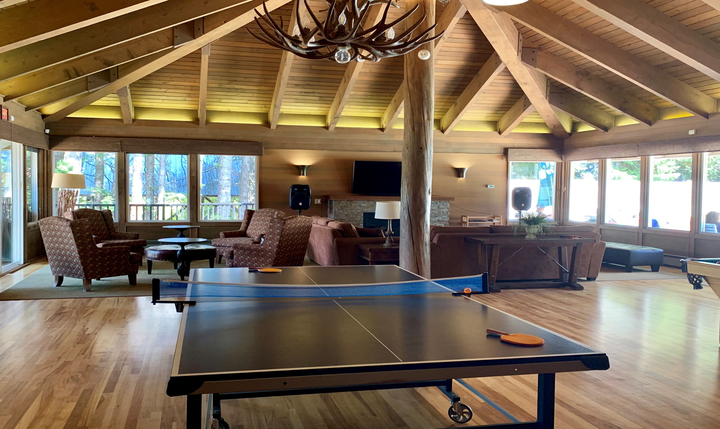
Pineloch Sun Beach Club
OUR MEETING
AGENDA
01
BOARD ROLE CALL
Meeting Overview: Mark
04
MEMBER ADMINISTRATIVE BUSINESS/REQUESTS
06
BOARD MEMBER ELECTIONS
02
INTRODUCTIONS OF MEMBERS PRESENT
05
COMMITTEE REPORTS
07
OPEN FORUM
Architecture: Bob
Communication: Celestina
Firewise: Linda
Roads & Maintenance: Ken
Technology: Dave
Treasury: Bonnie
Water: Loren & Robb
03
OLD BUSINESS
Secretary: Prior meeting minutes approved
Treasury Report: Bonnie
08
CONCLUSION

Slide 4
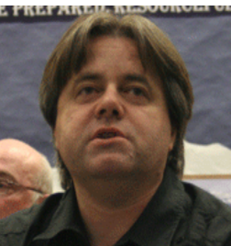
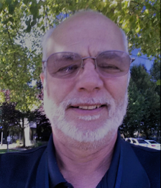
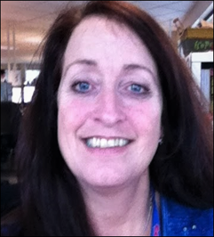
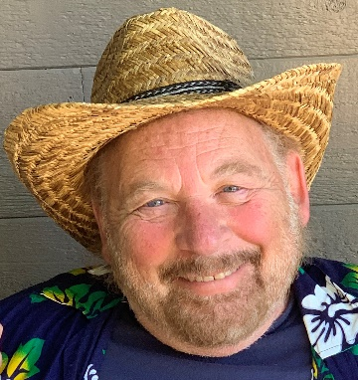
YOUR BOARD OF DIRECTORS
MARK
President
DAVE
Vice President
BOB
Secretary
BONNIE
Treasurer
KEN
Roads & Maintenance
ROBB
Water
CELESTINA
Communications
PINELOCHSUN.ORG

Slide 5
Bring back the natural life
OUR GUIDING PRINCIPLES
THE THREE RULES
01
TRANSPARENCY
02
CONSISTENTCY
03
CONTINUOUS IMPROVEMENT
Transparency of progress regarding agreed membership priorities – water, roads and maintenance.
Consistency of communication via multiple methods including website, email, mail, social media, etc.
Continuous improvement is how PLS is managed – for the good of our membership community.
WWW.ELSIE.COM

Slide 6
TREASURY

Slide 7
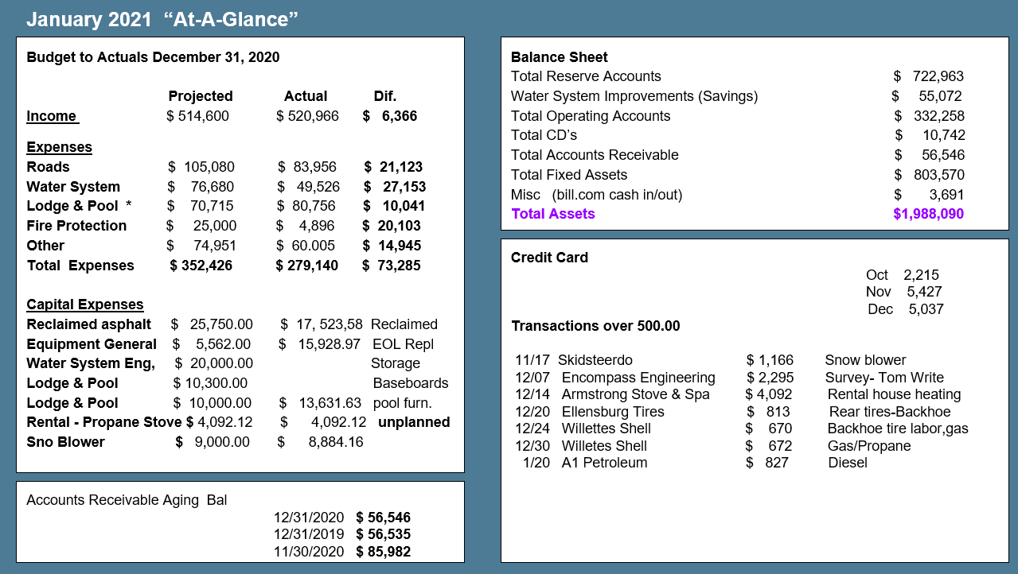
TREASURY REPORT
BUDGET COMMITTEE. We’re looking for volunteers to join the budget committee.
Your role would be to help us decide where to allocate funds, percentage of increase for maintenance line items, review the reserve study, etc.
Loren and Bonnie are always involved , but we’d like to extend the offer to any member who would like to be involved.

Slide 8
TECHNOLOGY

Slide 9
TECHNOLOGY
Community Web Cam(s). One of our awesome members is going to research options, costs, logistics, capabilities, etc. for a community web cam. Proposal will be presented at next Board meeting.

Slide 10
ROADS AND MAINTENANCE

Slide 11
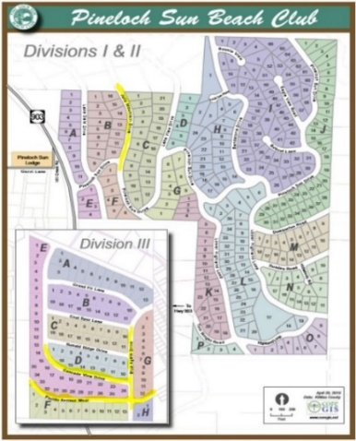
ROADS & MAINTENANCE
ROADS
During the snow….
Continue to groom per schedule OR based on need per weather conditions.
Continue to plow Tom Write road, PLS entrance and parking lots per weather conditions.
After the snow….
Assess and prioritize reclaimed asphalt application; order reclaimed asphalt per need.
Prepare for the spring road work and subsequent dust abatement.
Resolve Tom Write gate situation.
MAINTENANCE
Ongoing equipment repairs
New plow for the PLS truck will be installed as soon as possible.
Skid steer snowblower attachment received and working well.
Skid steer chipper attachment arrived and will be ready for service entering Spring.

Slide 12
ROADS & MAINTENANCE
ROAD WORK, KUDOS, IMPROVEMENT OPPORTUNITIES & ISSUES
Work done to Division 3 Ditches over the summer has been a success mitigating historical flooding issues.
Clean up and maintain entrance to home at the Tom Write road gate.
Research/Identify safety enhancements related to Division 1 & 2 ditches and road junctions
Locate and repair leaks
Research improvements for Camp Chaos Parking lot and Tom Write road drainage and mud issue.

Slide 13
FIREWISE

Slide 14
WATER

Slide 15
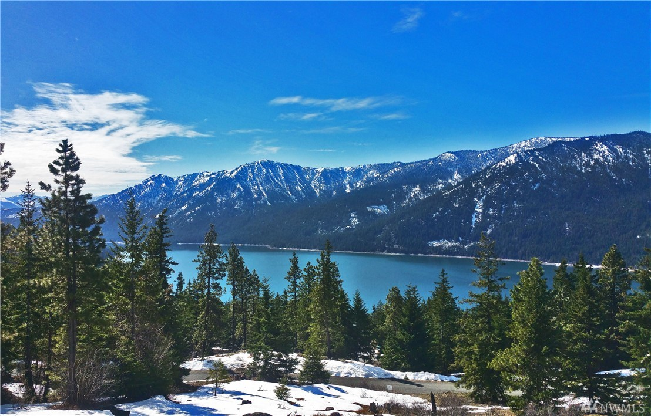
WATER
WATER
1. Water losses....occurrences and repairs
2. Required maintenance performed
3. Water issues related to cold weather conditions
4. Status of engineering study

Slide 16
ARCHITECTURE

Slide 17
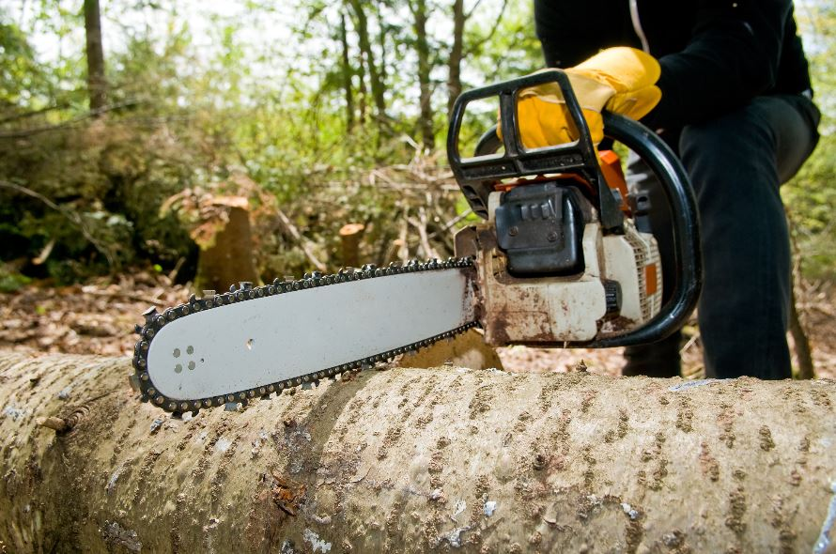
ARCHITECTURE
No architectural requests
2 tree removal requests

Slide 18
COMMUNICATION

Slide 19
COMMUNICATIONS
CONNECTING OUR MEMBERS. We use various tools to inform & connect our members through their preferred method of communication – letters, email, Facebook, notices in Lodge, etc.
FACEBOOK PAGE. PLS Private Members Group has ~370 members. This is the best way to get quick information and reach out to the community.
WEBSITE. You can find “What’s Happening” and “What’s New” on the homepage of pinelochsun.org, along with links to the live cam, meeting minutes and other helpful items.
MAILED LETTERS. We also send out physical letters when we must ensure every member receives the information like the annual Treasury Report and parking passes.
TREETOP TIMES eNEWSLETTER. We send out our eNewsletter whenever we have important information and fun facts to get out to our members.
SIGNAGE. Notices are displayed in the Lodge and on the white board at the entrance.
Please make sure we have your email address so you can get the Treetop Times and join our Facebook Group – if you have Facebook.

Slide 20
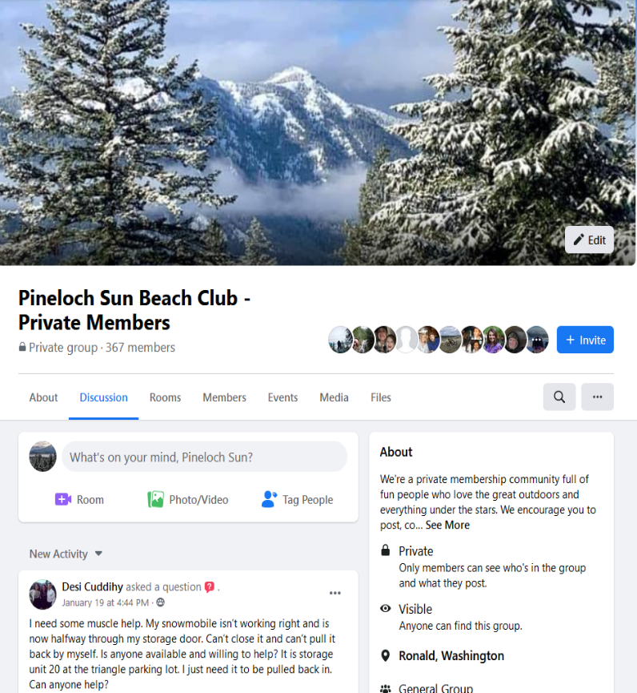
Pineloch Sun Beach Club
CONNECTING OUR COMMUNITY
Pinelochsun.org
Private Facebook Group
Treetop Times eNewsletter
PINELOCHSUN.ORG

Slide 21
Q&A

Slide 22
THANK YOU!

Slide 23
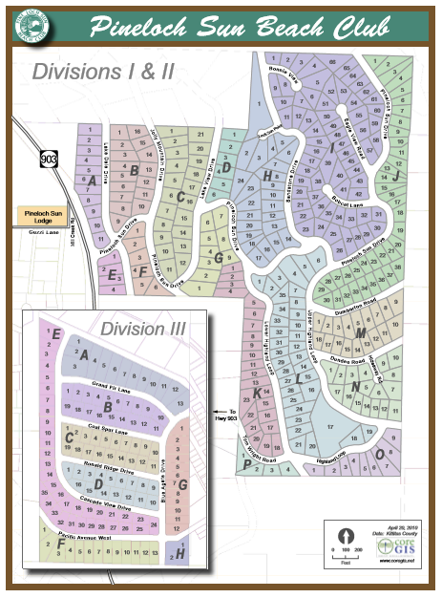
PLS MAP
Please see our PLS map as a visual reference for our Divisions, roads, utilities, maintenance and other areas of concern roads / utilities / maintenance and other areas of concern.

Slide 24
Pineloch Sun
Private Property
Do not enter!

