Slide 1
PINELOCH SUN BOARD MEETING
JULY 27, 2019

Slide 2
Bring back the natural life
THE THREE RULES
OUR GUIDING PRINCIPLES
01
TRANSPARENCY
02
CONSISTENTCY
03
CONTINUOUS IMPROVEMENT
Transparency of progress regarding agreed membership priorities – water, roads and maintenance.
Consistency of communication via multiple methods including website, email, mail, social media, etc.
Continuous improvement is how PLS is managed – for the good of our membership community.
WWW.ELSIE.COM

Slide 3
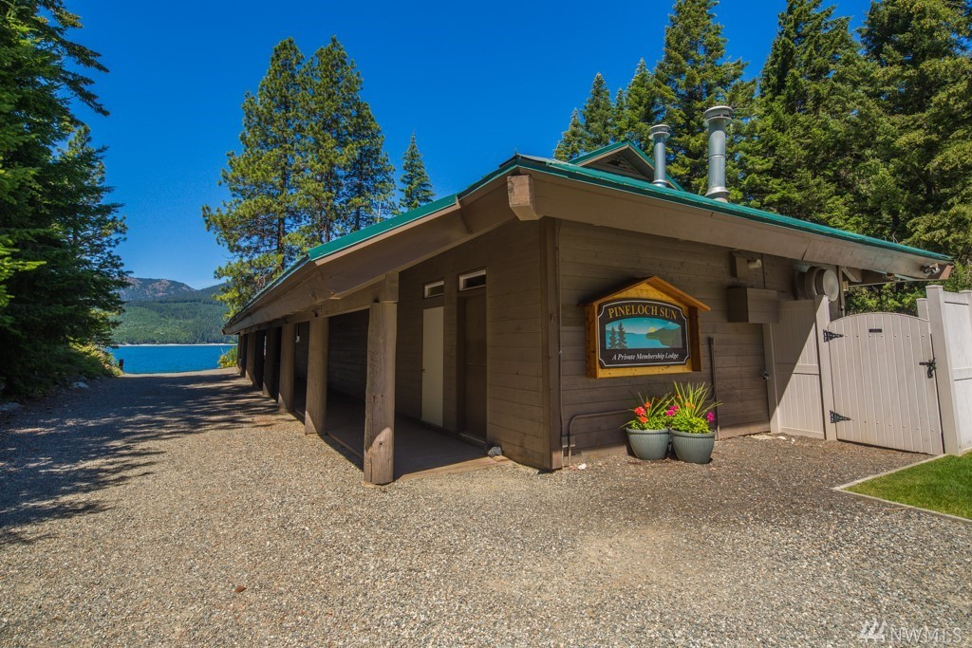
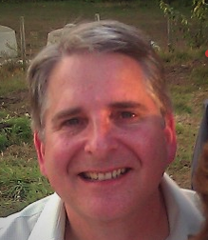
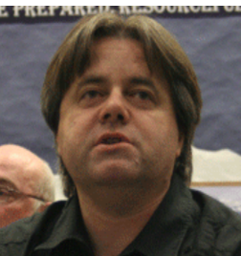
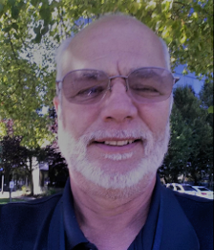
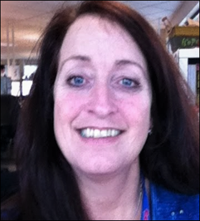
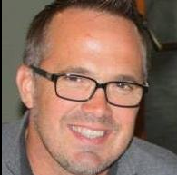
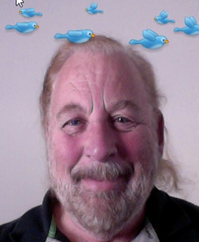
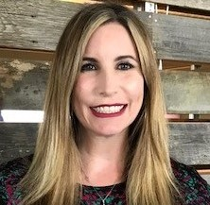
YOUR BOARD OF DIRECTORS
MARK
President
DAVE
Vice President
BOB
Secretary
BONNIE
Treasurer
KEN
Roads & Maintenance
ROBB
Water
CELESTINA
Communications
Committed to transparency, consistency, and continuous improvement
for the good of our membership.
WWW.INLANDNET.COM/PINCELOCH

Slide 4
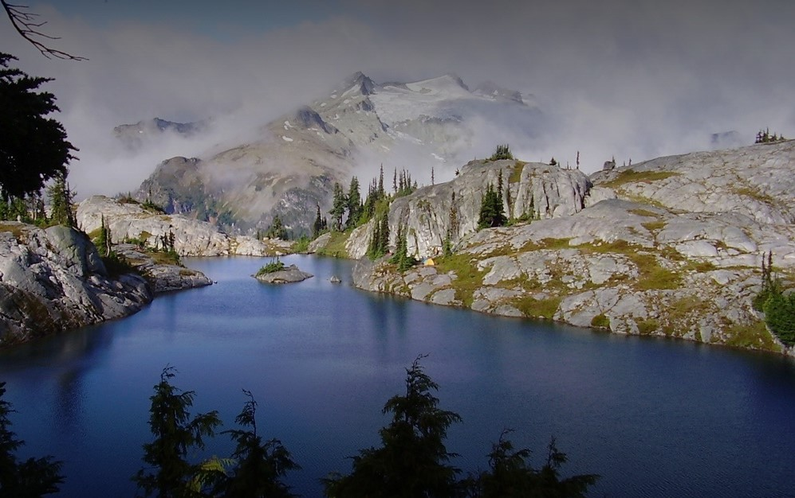
Pineloch Sun Beach Club
OUR MEETING
AGENDA
01
BOARD ROLE CALL
04
MEMBER ADMINISTRATIVE BUSINESS/REQUESTS
06
NEXT MEETING NOTICE
DATE
02
INTRODUCTIONS OF MEMBERS PRESENT
05
COMMITTEE REPORTS
07
CONCLUSION
Technology: Dave
Firewise: Linda
Water: Robb
Roads & Maintenance: Ken
Architecture: Bob
Budget: Bonnie
Communication: Celeste
03
OLD BUSINESS
Secretary: Prior meeting minutes
Treasury: Status Report

Slide 5
OLD BUSINESS

Slide 6
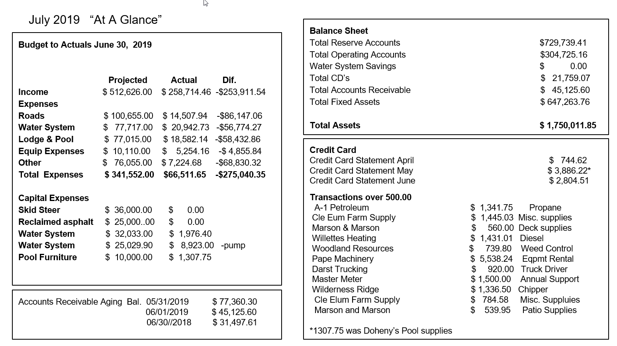

Slide 7
TECHNOLOGY

Slide 8
TECHNOLOGY
UPDATE
We are working on adding the camera feed to the new website.
Update 2

Slide 9
FIREWISE

Slide 10
WATER

Slide 11
ROADS & MAINTENANCE

Slide 12
BUDGET

Slide 13
COMMUNICATIONS

Slide 14
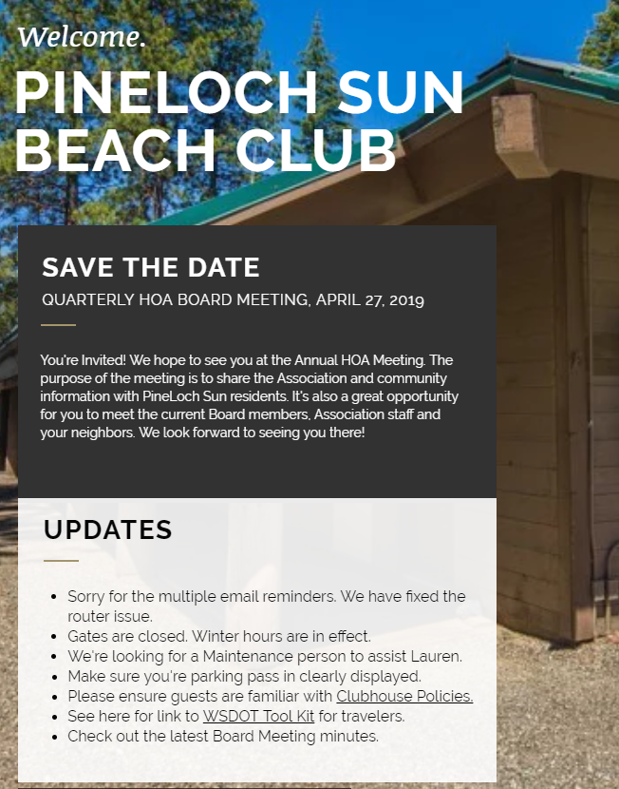
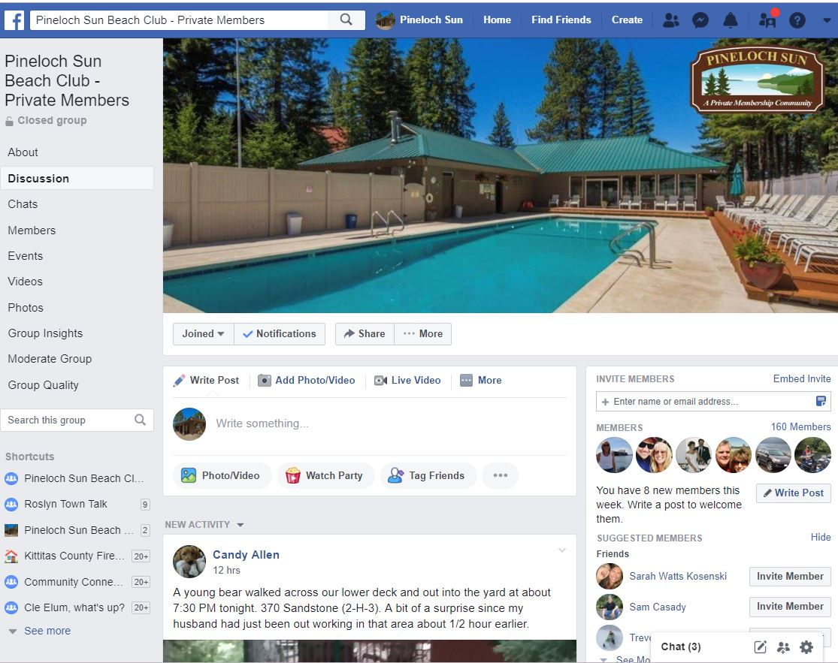
Pineloch Sun Beach Club
CONNECTING OUR COMMUNITY
WEBSITE
FACEBOOK GROUP
TREETOP TIMES
PINELOCHSUN.ORG

Slide 15
JOIN US!
2ND ANNUAL CHILI COOK-OFF
Sept. 1st, 2019
Bring your favorite homemade chili and compete with your neighbor for cool prizes and bragging rights!! No secret family recipe to share? No problem, come down to the Clubhouse and bring your taste buds!
Noon: Judging begins
12:30PM: People’s Choice tasting begins
1:30PM: Prizes awarded

Slide 16
THANK YOU

