Slide 1
PINELOCH SUN ANNUAL HOA BOARD MEETING
SEPTEMBER 21, 2019

Slide 2
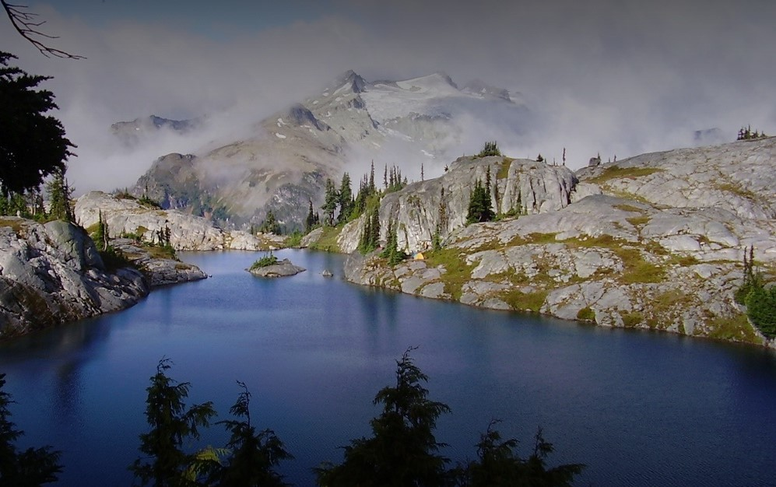
Pineloch Sun Beach Club
OUR MEETING
AGENDA
01
INTRODUCTIONS OF MEMBERS PRESENT
03
OPERATING BUDGET Q&A. VOTE
02
COMMITTEE REPORTS
04
BOARD MEMBER ELECTION
Treasury: Mark (for Bonnie)
Technology: Celeste (for Dave)
Firewise: Linda Orndorff
Water: Robb
Roads & Maintenance: Ken
Architecture: Mark
Communication: Celestina
05
CONCLUSION

Slide 3
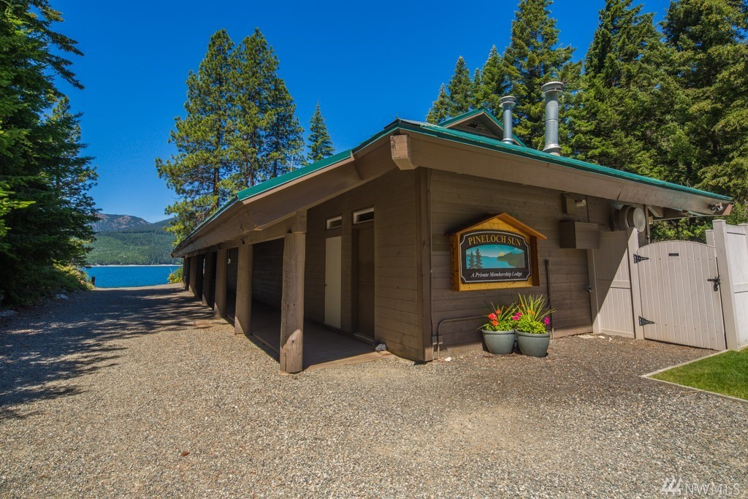
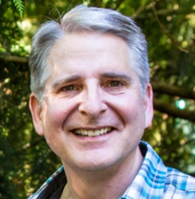
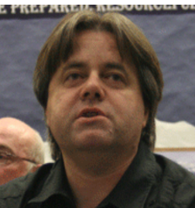
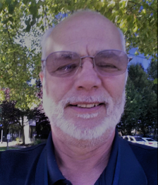
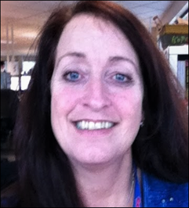
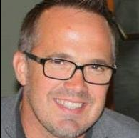
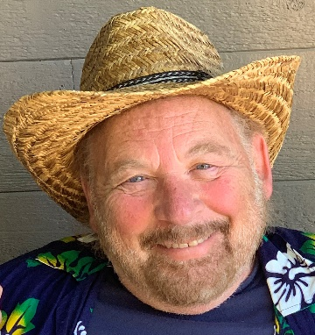
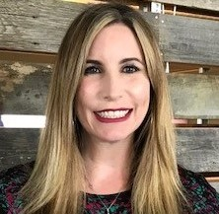
YOUR BOARD OF DIRECTORS
MARK
President
DAVE
Vice President
BOB
Secretary
BONNIE
Treasurer
KEN
Roads & Maintenance
ROBB
Water
CELESTINA
Communications
PINELOCHSUN.ORG

Slide 4
Bring back the natural life
THE THREE RULES
OUR GUIDING PRINCIPLES
01
TRANSPARENCY
02
CONSISTENTCY
03
CONTINUOUS IMPROVEMENT
Transparency of progress regarding agreed membership priorities – water, roads and maintenance.
Consistency of communication via multiple methods including website, email, mail, social media, etc.
Continuous improvement is how PLS is managed – for the good of our membership community.
WWW.ELSIE.COM

Slide 5
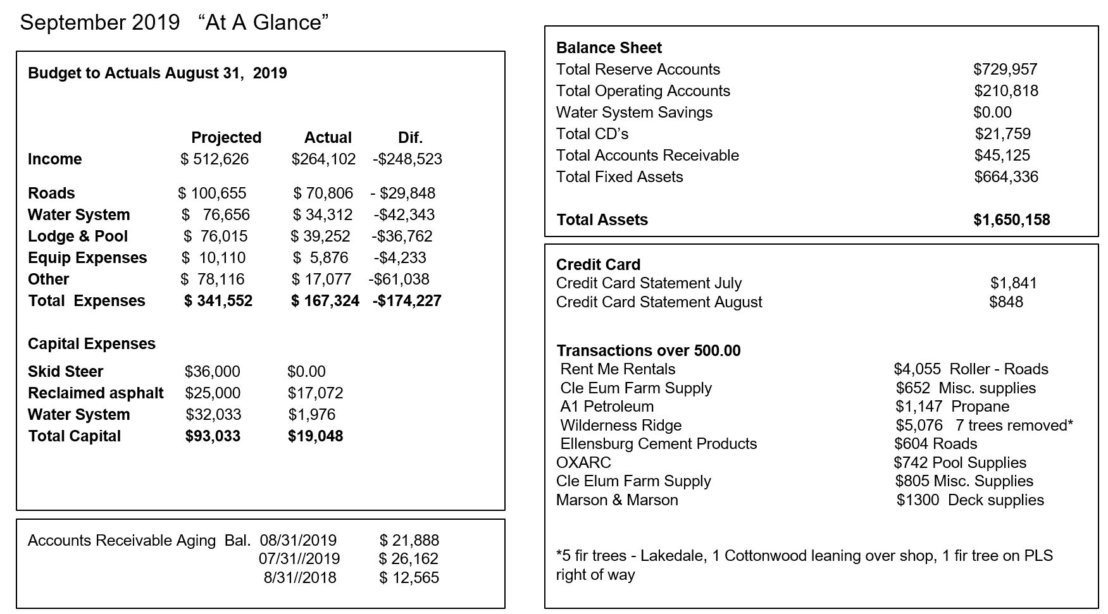
TREASURY REPORT

Slide 6
TREASURY KEY ACCOMPLISHMENTS
Wrap around deck, railings, & new patio complete
Pool filter replaced
Skid Steer purchased
PRIORITES FOR 2020:
Paint exterior of lodge, shop & garage
Replace pool furniture
Replace office equipment
Replace lodge baseboard heaters
Purchase reclaimed asphalt to redo roads, per roads plan

Slide 7
TREASURY
QUESTIONS/COMMENTS?

Slide 8
TECHNOLOGY

Slide 9
TECHNOLOGY
WI-FI RANGE EXTENDERS:
Wi-Fi coverage extended to the pool area.
Extenders will be added for lakeside deck next spring.
Passwords no longer required in the lodge area.
WEBSITE: The www.Pinelochsun.org website is up and running! We are no longer updating the old site.
LIVE CAMERA: Our cameras are currently linked to old website site, so we’ll keep it up as long as the camera feeds to that site.

Slide 10
TECHNOLOGY
QUESTIONS/COMMENTS?

Slide 11
FIREWISE

Slide 12
FIREWISE
REQUEST FOR VOLUNTEER(S).
We are looking for a volunteer(s) to spearhead our Firewise initiatives. Linda has done an amazing job, and now she’s ready to pass the baton.
Responsible for helping keep us compliant with our Firewise responsibilities to remain a recognized Firewise community.
Help us identify any grant funds that might be available for community improvements. No funds are currently available.
FREE FIREWISE ASSESSMENT. The Kittitas Conservation District does free assessments for our members. 509.925.3352.
Wendy Mee: wendy-mee@conservewa.net
Brent Dixon: brent-Dixon@conservewa.net
FIREWISING YOUR PROPERTY. We participate in the Roving Chipper Program
and have Little Arizona to discard natural debris (no construction waste).

Slide 13
WATER

Slide 14
WATER
WATER UTILIZATION Efficiency & CONSUMER CONFIDENCE reports submitted and accepted by WA Department of Health (WDOH). A copy of the Consumer Confidence report is available at pinelochsun.org, under the documents tab. A copy is also available on the WDOH "Sentry" website.
A DIVISION III PRESSURE PUMP (variable speed) was added to help maintain more consistent water pressure at times of high demand. Outdated infrastructure was removed and operating costs will decrease.
TELEMETRY SYSTEM: Loren and Robb will be exploring the possibility of taking advantage of the more modern fiber optic technology to improve our telemetry. Telemetry upgrade assessment is in the data gathering stage; a proposal for improving our system will be prepared and submitted to the Board this winter.
WATER STORAGE. We are revisiting the conversation around additional water storage. The additional contact time between water and odor control chemicals (chlorine) would improve the abatement of odor issues in DIV III. Robb will include all PLS water stations in assessment to determine if additional storage capacity would be beneficial if applied across the entire water distribution system.

Slide 15
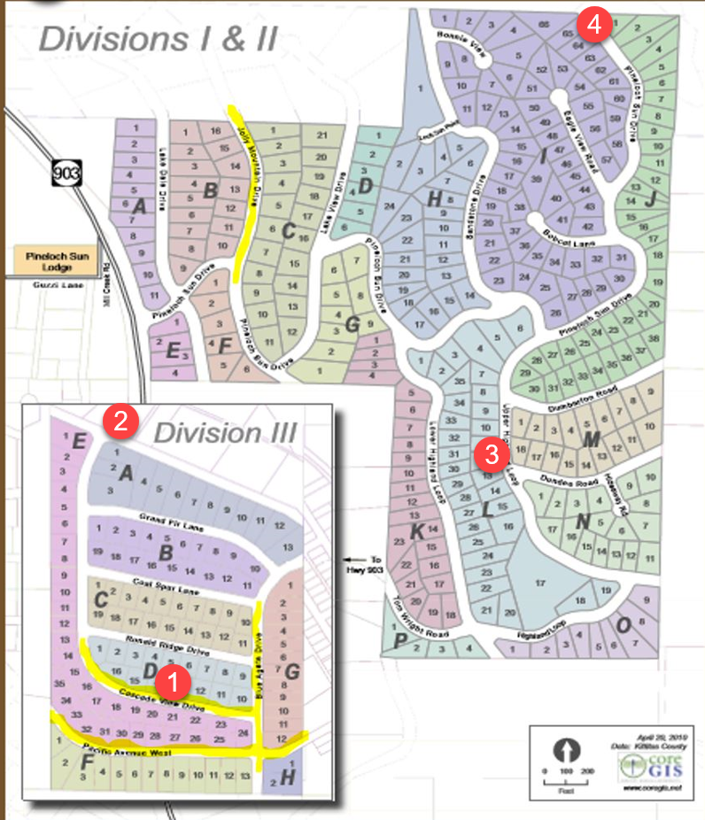
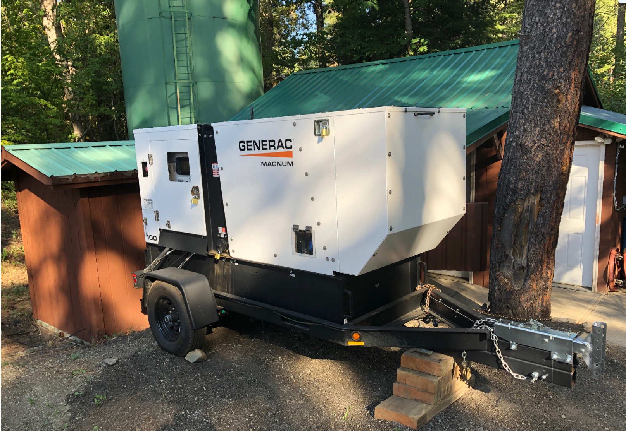
WATER
EMERGENCY POWER for use in our water system stations 1 & 2. These stations service the water treatment infrastructure and pump water to all tanks of PLS.

Slide 16
WATER
QUESTIONS/COMMENTS?

Slide 17
ROADS & MAINTENANCE

Slide 18
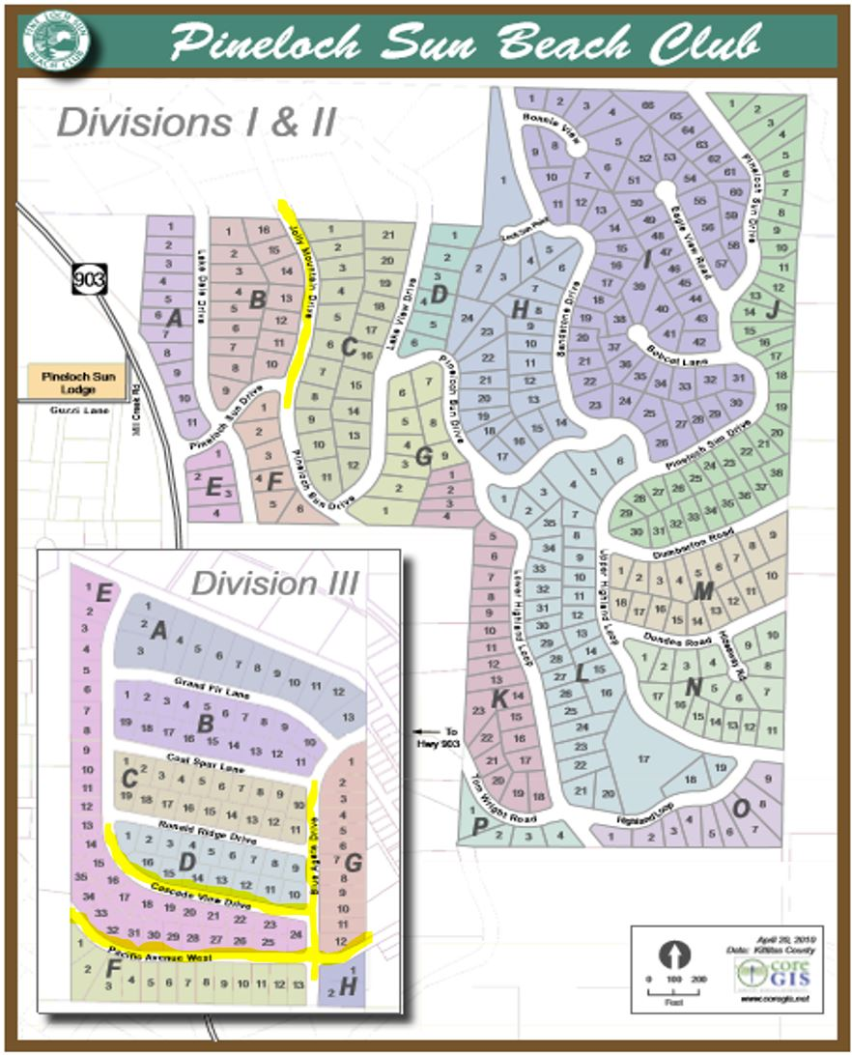
ROADS & MAINTENANCE
Every Pineloch Sun road has been done at least once over the last three years and the ongoing plan is to continue to purchase 1,000 tons of reclaimed asphalt & apply it to the roads where and when needed. The actual selection of the areas to improve & maintain will be determinized in Springtime.
All PLS roads were graded, rolled and had dust abatement applied. The yellow highlighted roads were repaired with new reclaimed asphalt.

Slide 19
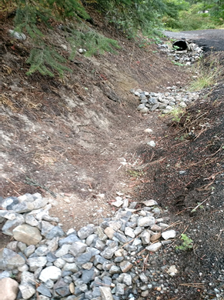
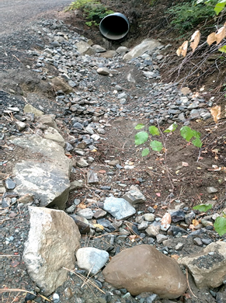
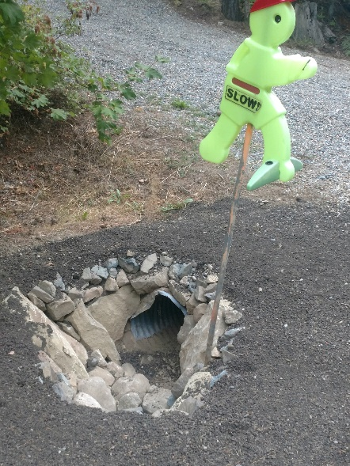
ROADS & MAINTENANCE
DITCHES & CULVERTS. We have put a lot of effort into improving the PLS ditches and culverts in Divisions I & II and will start work in Division III as soon as we finish on the hill.

Slide 20
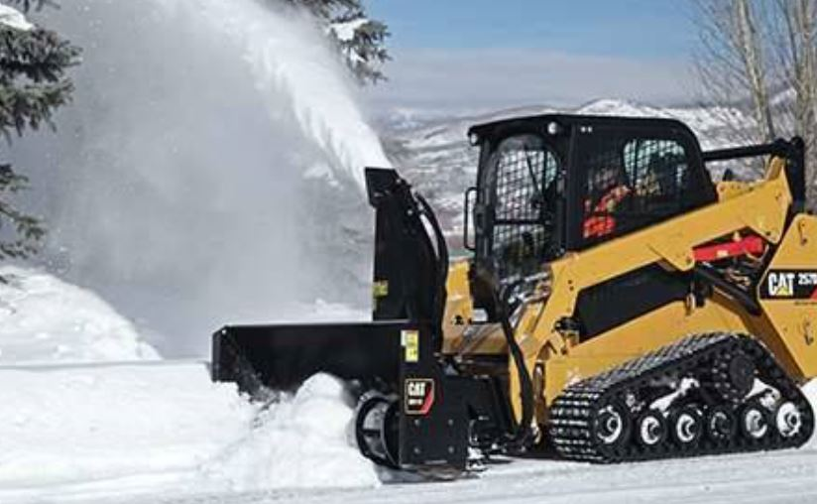
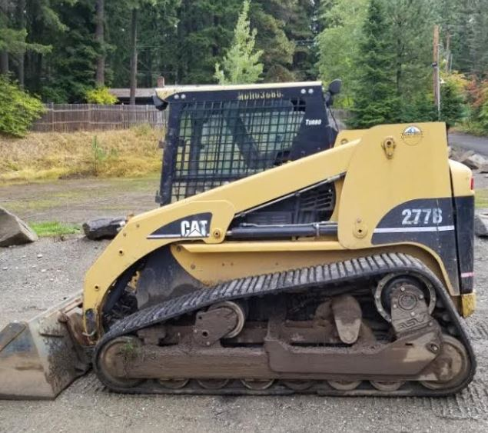
ROADS & MAINTENANCE
SKID STEER - We recently purchased a 2005 cat 277B skid steer loader and are planning to purchase a new slower blower attachment. The plan is to use it to keep our roads from getting narrow when the plow truck can’t throw the snow up and out of the road because the banks are too high. More winter-time parking!!
THE NEWEST MEMBER OF THE PLS FAMILY. ISN’T SHE BEAUTIFUL.

Slide 21
ROADS & MAINTENANCE
ROADS & MAINTENANCE
QUESTIONS/COMMENTS?

Slide 22
ARCHITECTURE

Slide 23
ARCHITECTURE
TREE REMOVAL. We received 14 tree removal requests. All approved.
NEW CONSTRUCTION. 3 new cabins
REMODELS. 2 remodels

Slide 24
COMMUNICATIONS

Slide 25
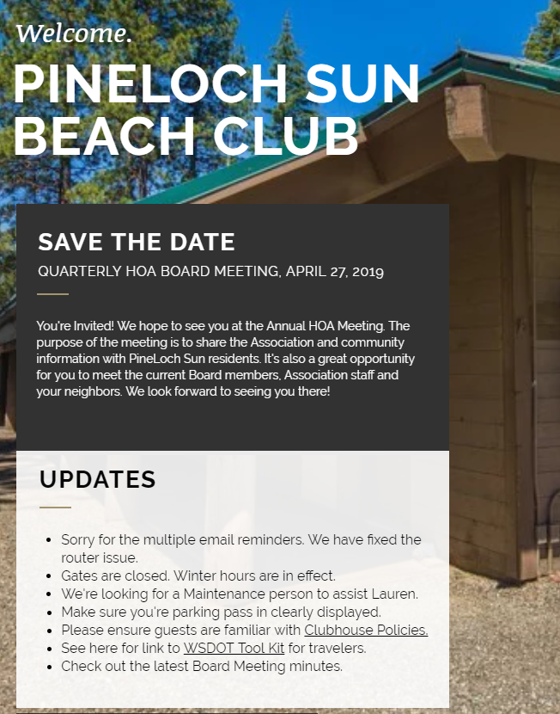
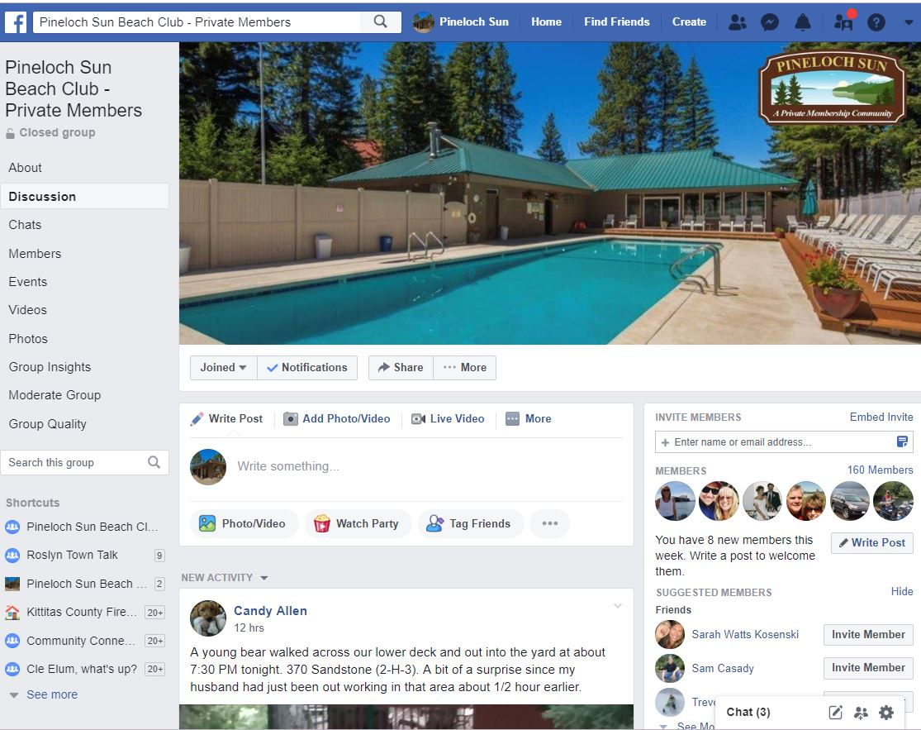
Pineloch Sun Beach Club
CONNECTING OUR COMMUNITY
WEBSITE
FACEBOOK GROUP
TREETOP TIMES
PINELOCHSUN.ORG

Slide 26
COMMUNICATIONS
CONNECTING OUR MEMBERS. We’re using various tools to inform & connect our members through their preferred method of communication – email, social media, notices in Lodge, etc.
FACEBOOK PAGE. We want to create a forum where people can connect, inform, notify, sell, ask, vent, laugh, be heard, etc. If a topic gets too heated, please PM me. I want you to feel heard and will do what I can to resolve the issue.
COMMUNITY EVENTS. Holiday Lights Parade. Between Christmas & New Years. PLS Nifty 50.
NEW SIGNAGE. We are updating the signage in our Lodge.
THANK YOU. A big “thank you” to Loren for everything. He has been my right-hand man, helping me answer questions & find solutions to issues that get brought up on our Facebook page. He’s amazing and we’re lucky to have him.

Slide 27
COMMUNICATION
QUESTION: EVENTS – LOVE THEM. LIKE THEM. HATE THEM?

Slide 28
BUDGET

Slide 29
BUDGET HIGHLIGHTS
RESERVES. Reserves reached 100% of fully funded trend for both water and general.
2020 PLAN. Project plan completed for 2020.
HOA DUES. Homeowner dues will remain the same for 2020, no increases at this time.
Provides for annual operations, planned projects (per reserve study and water plan) and accumulates
reserves for longer term capital projects per reserve study.

Slide 30
BUDGET QUESTIONS/VOTE

Slide 31
BOARD MEMBER ELECTIONS

Slide 32
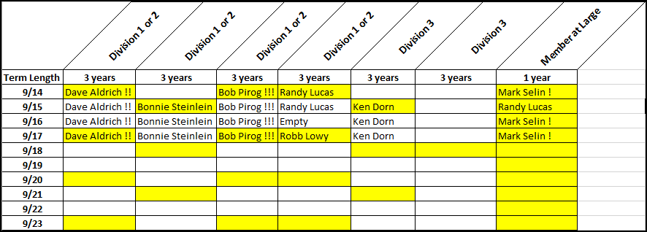
BOARD ELECTIONS
Voting On:
Mark Selin, President -1 year term ‘at large’
Celeste Murphy - Communications

Slide 33
THANK YOU!

